Slide 1

Health Plus
Team Members:
Ching-Fong Chen 001563042
Sampada Dhole 001526241
Rutuja Ghogare 002924946

Slide 2
Background
The future of the Long-term care system and old age homes may look quite different today. With aging infrastructure in some countries and increased demand for organizations interested in delivering resources and services.
Health Plus would act as a bridge between enterprises and global members. Users will be able to offer services and easily connect to medical support. Health Plus also keeps track of the data and various types of service roles.

Slide 3
Global availability
Cross-regional communication
Health Plus is a lightweight application offering global long-term care organizations
Data Tracking
Store statistics to monitor status and create basic data visualization
DB4O Databases
DB4O database increase the performance and functionalities while decreasing bandwidth requirements in remote areas.

Slide 4
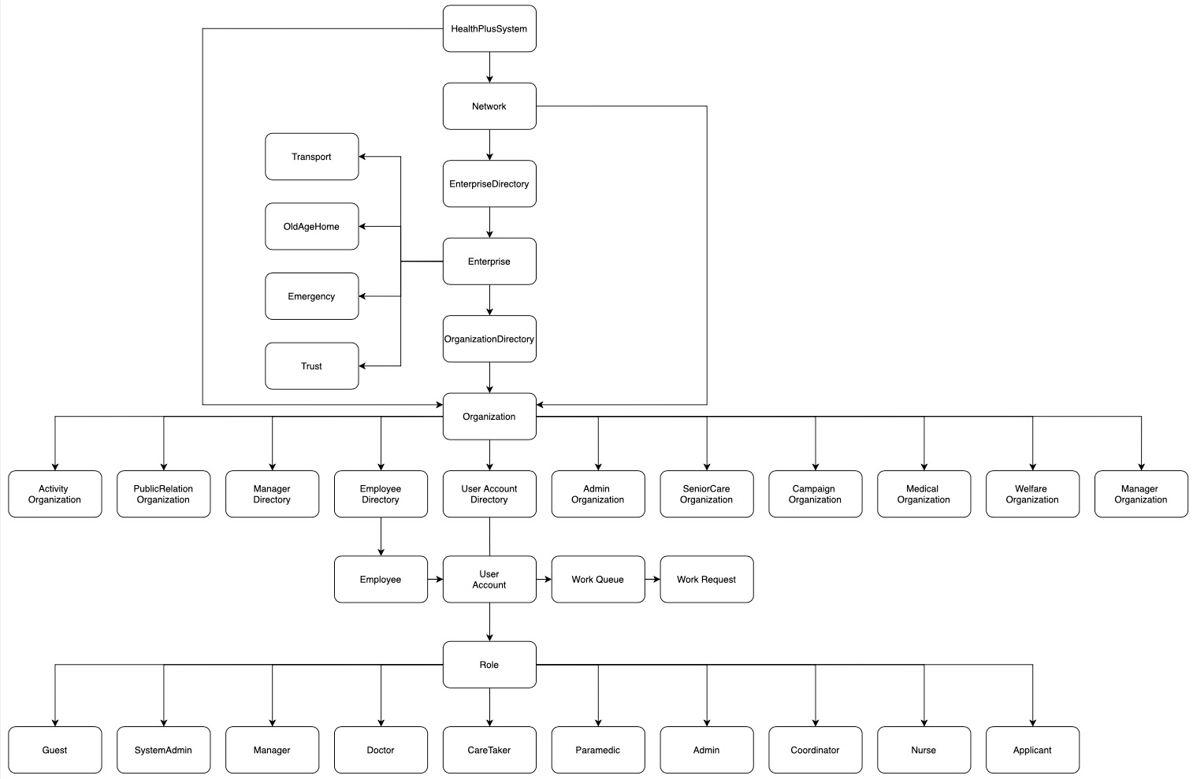
Health Plus’s Architecture

Slide 5
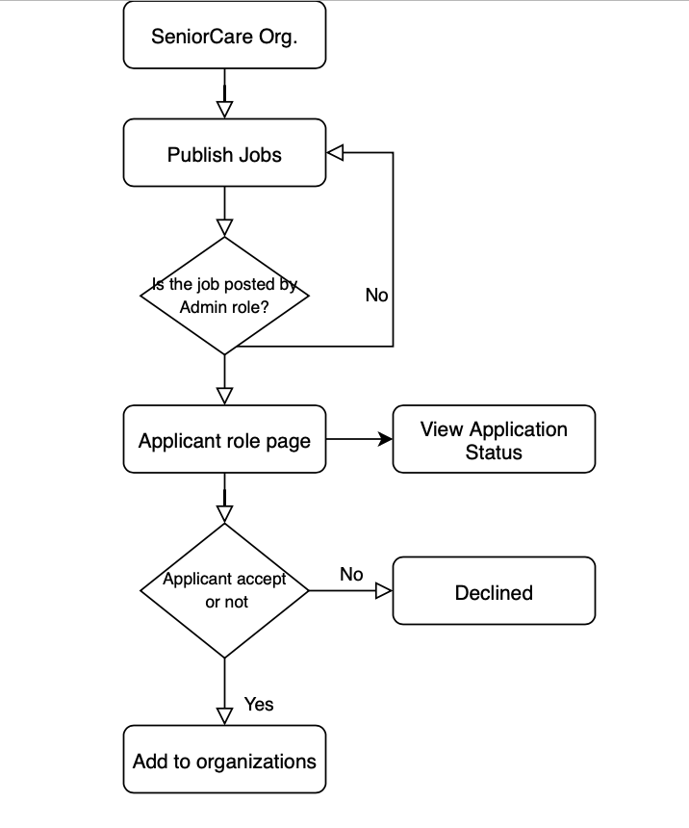
Work requests – Job application (Organization)
Logical Alignment

Slide 6
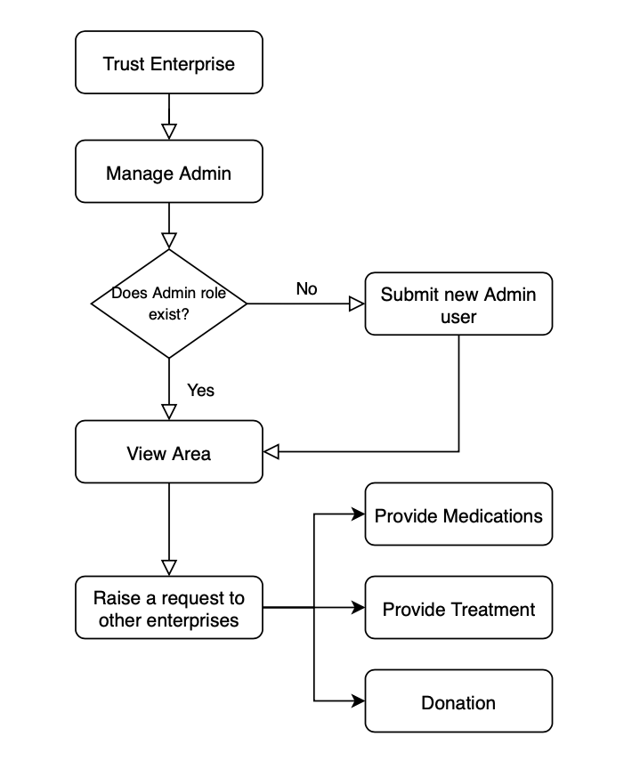
Work requests – Raise requests (Enterprise)

Slide 7
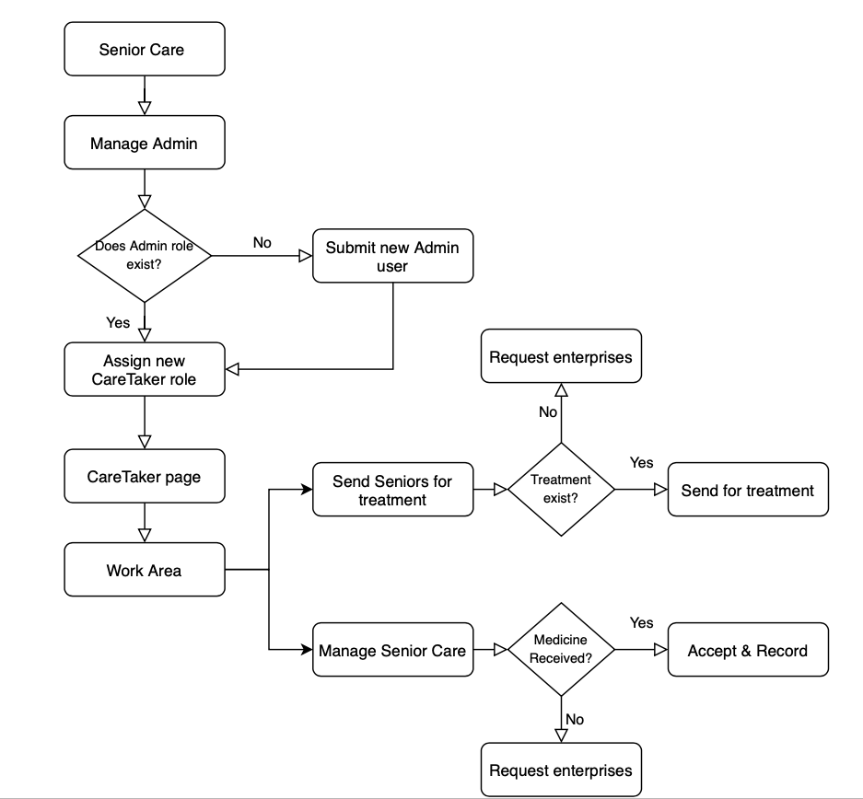
Work requests – Resource distribution (Enterprise)
Track Status

Slide 8
How to SOLVE issues
Help organizations to involve in healthcare resource integration
Every role of the care system can monitor the data to do quick decisions
Job vacancies will offer local opportunities to strengthen old age services
Medical treatment, donations, or medicines will deliver with tracking and efficiency

Slide 9
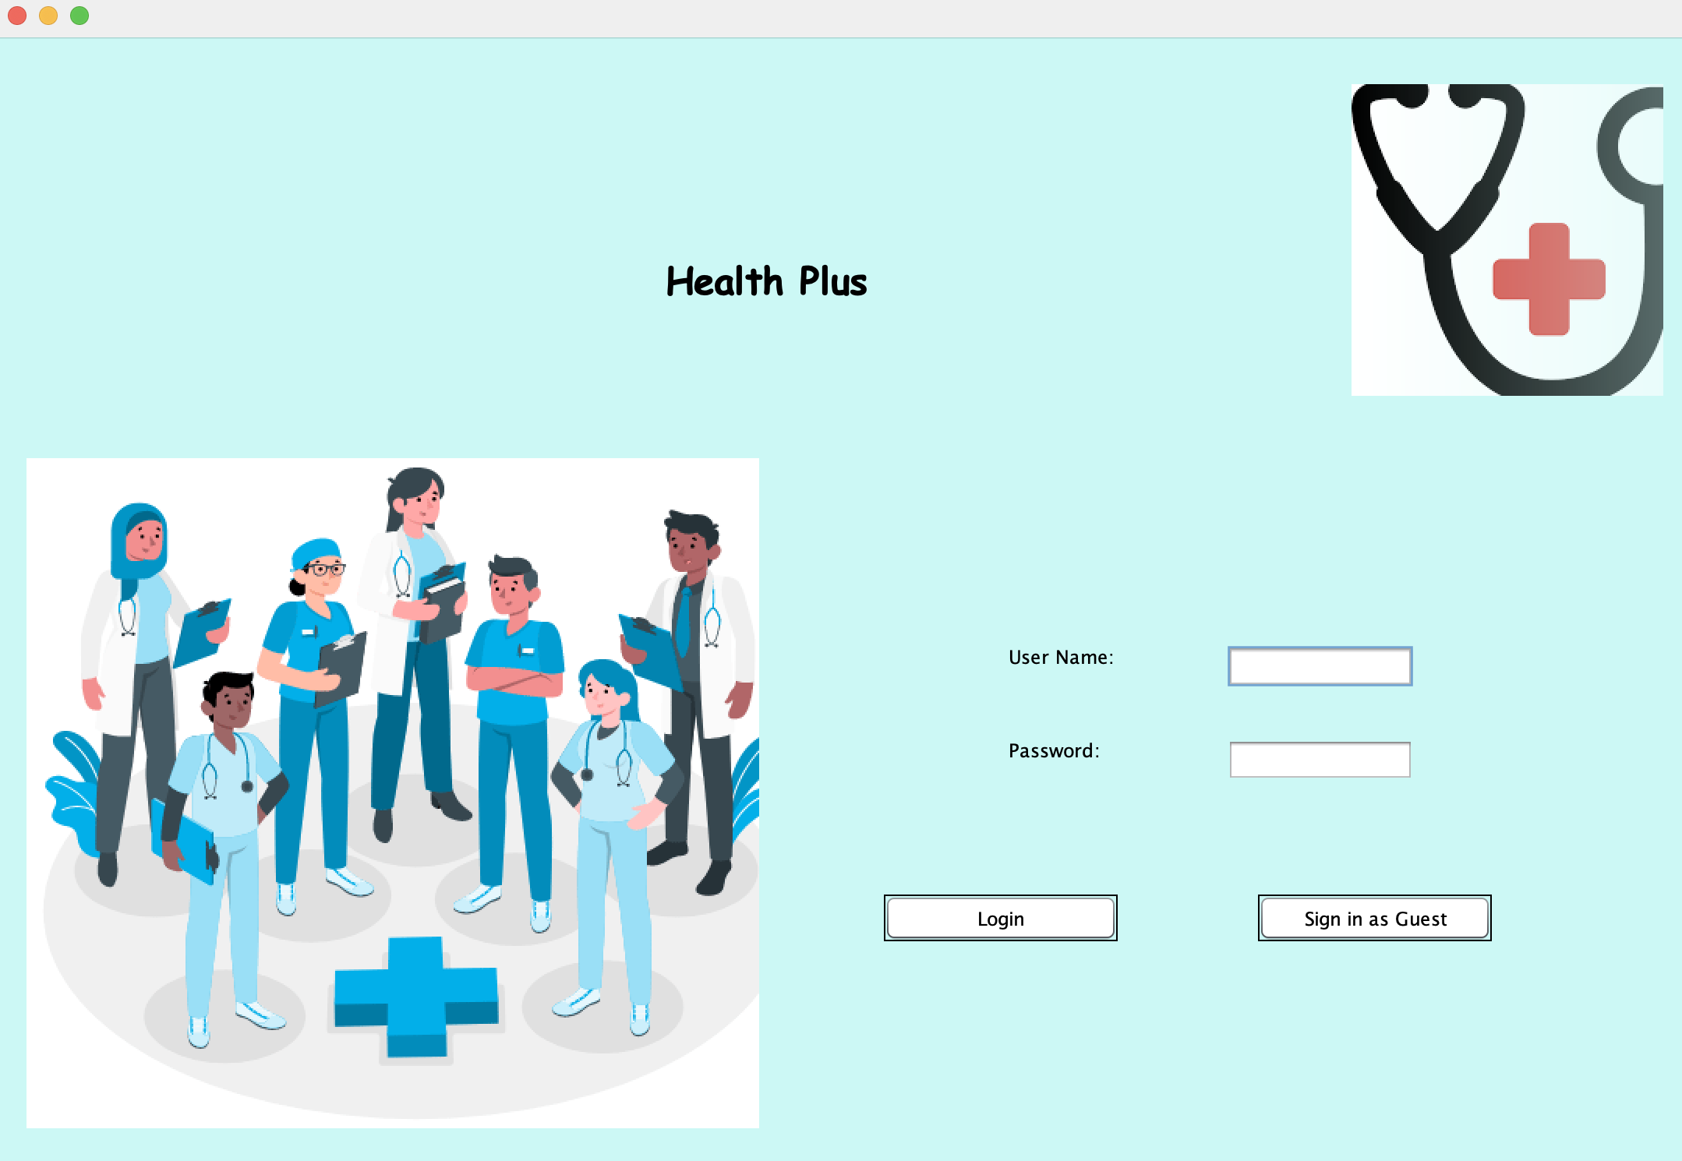
UI/UX - Login
Concise and understandable starting point of application
*Color consistence

Slide 10
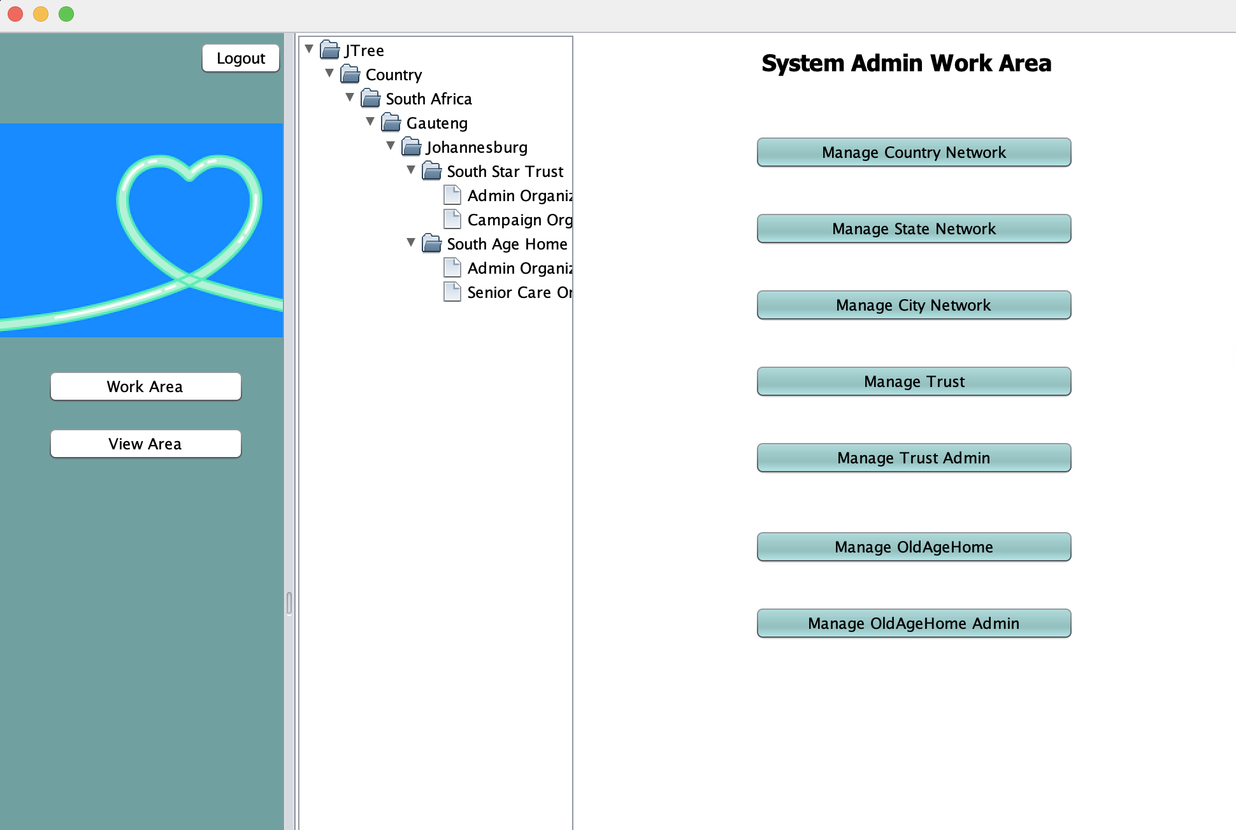
UI/UX – System Admin Work Area
Organized hierarchical structure for users
*Symmetry layout

Slide 11
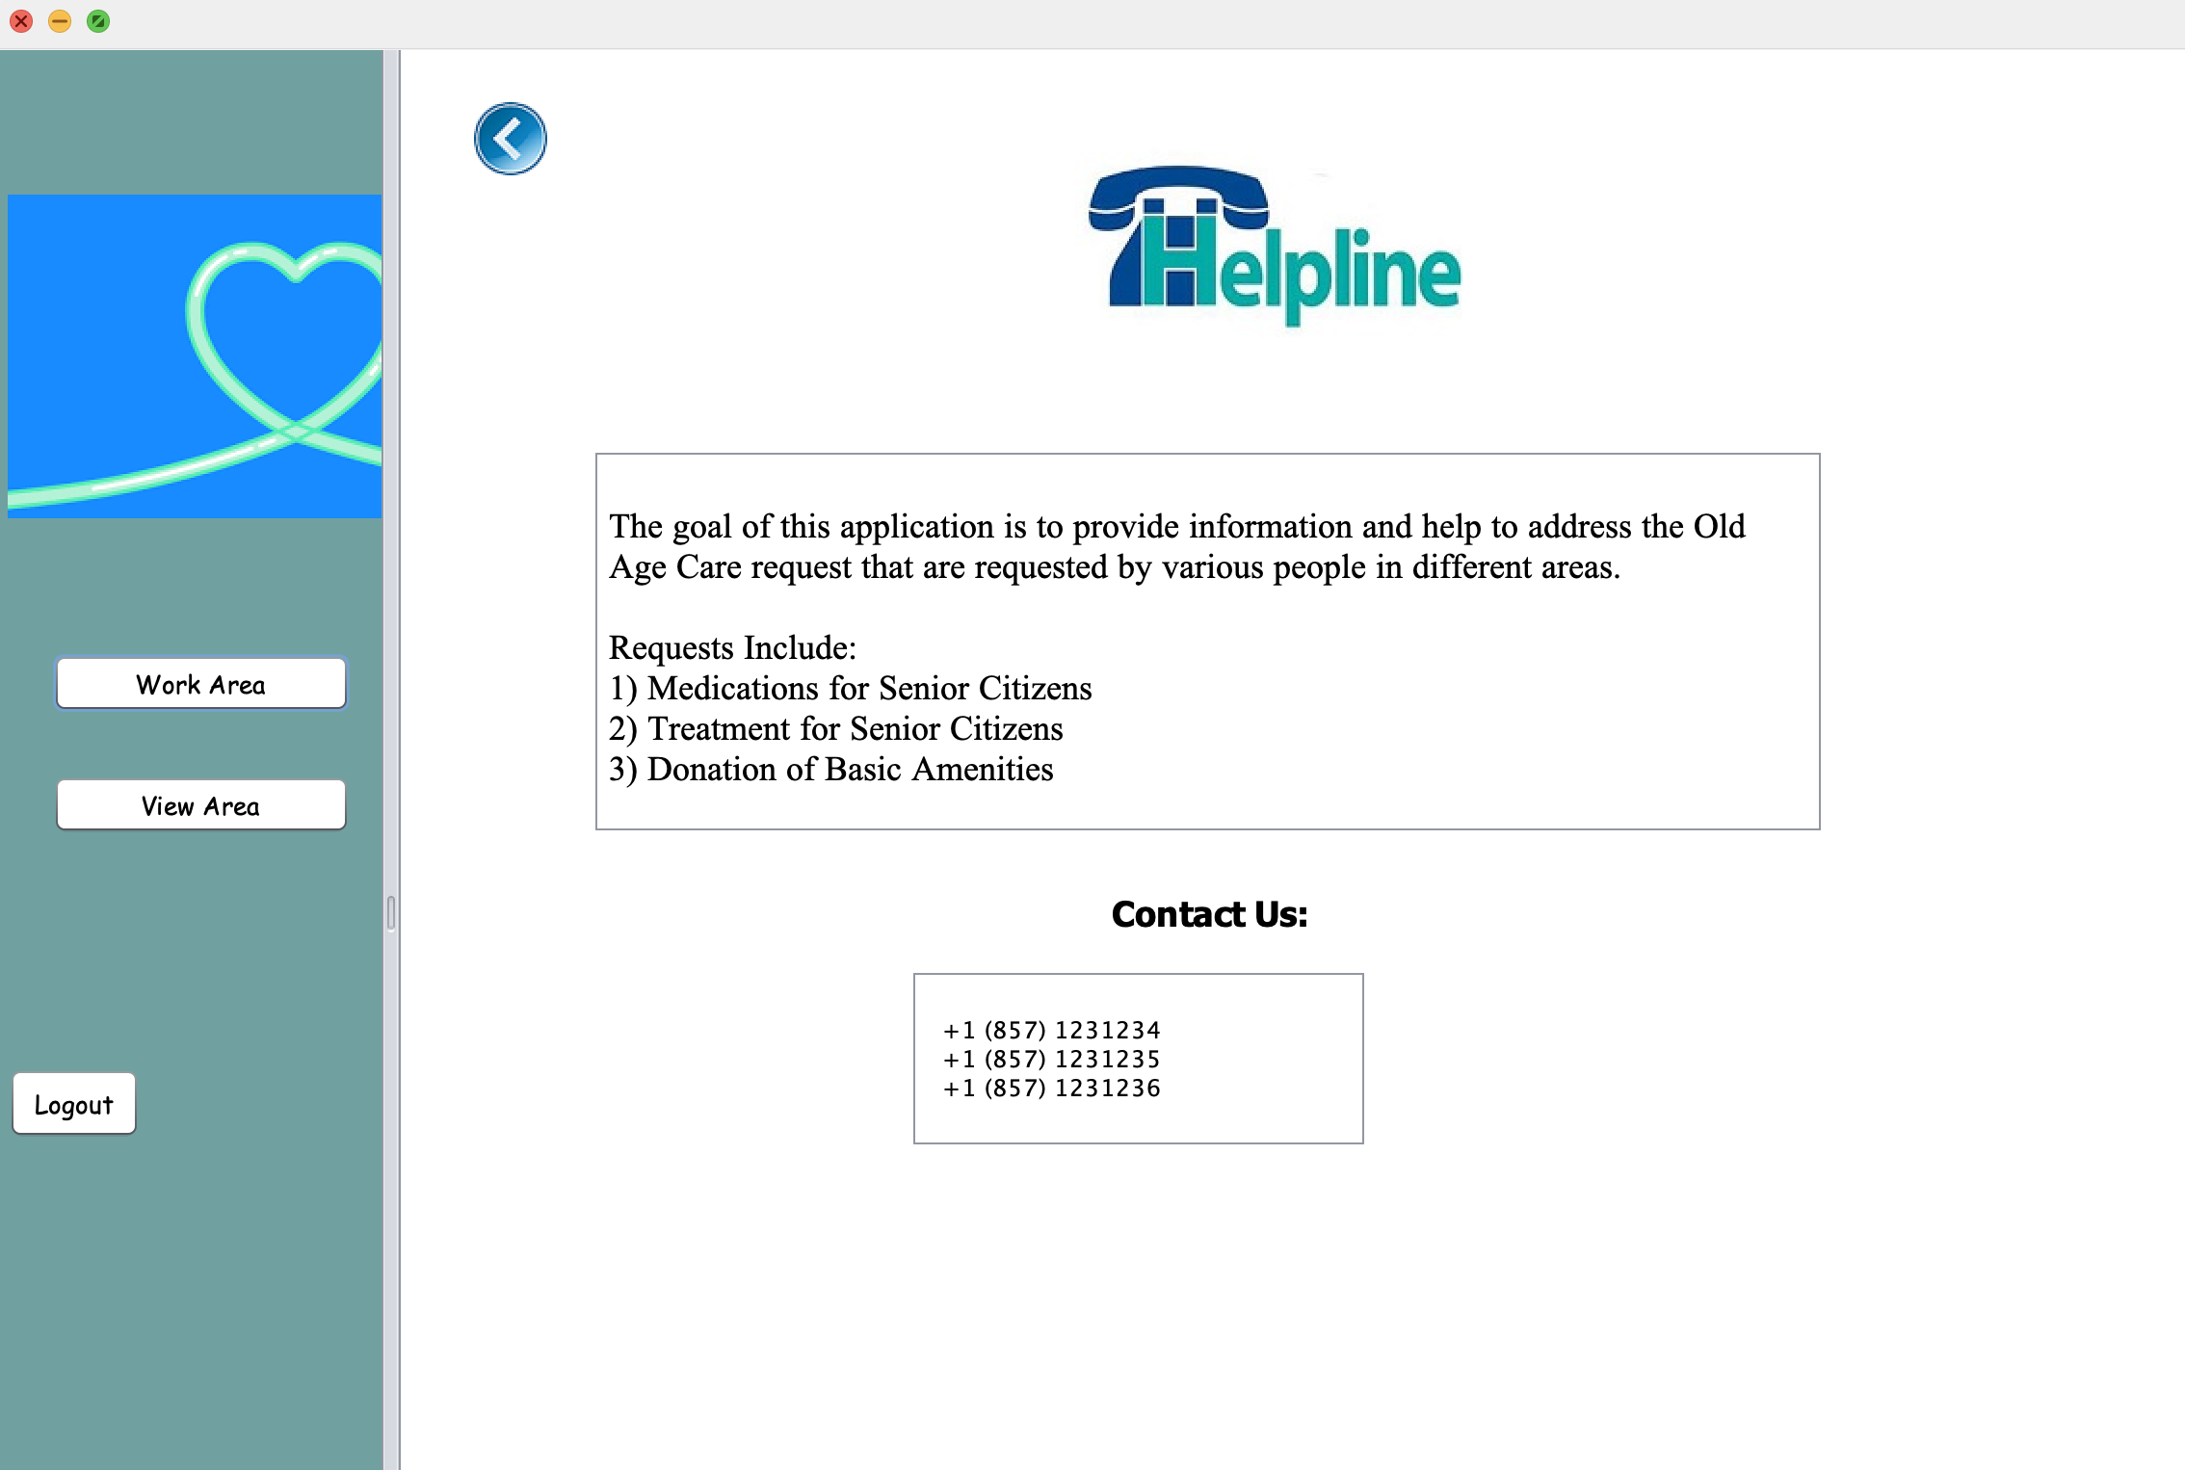
UI/UX – Contact Info
Clear contact information for every kind of user, even elders can read easily

Slide 12
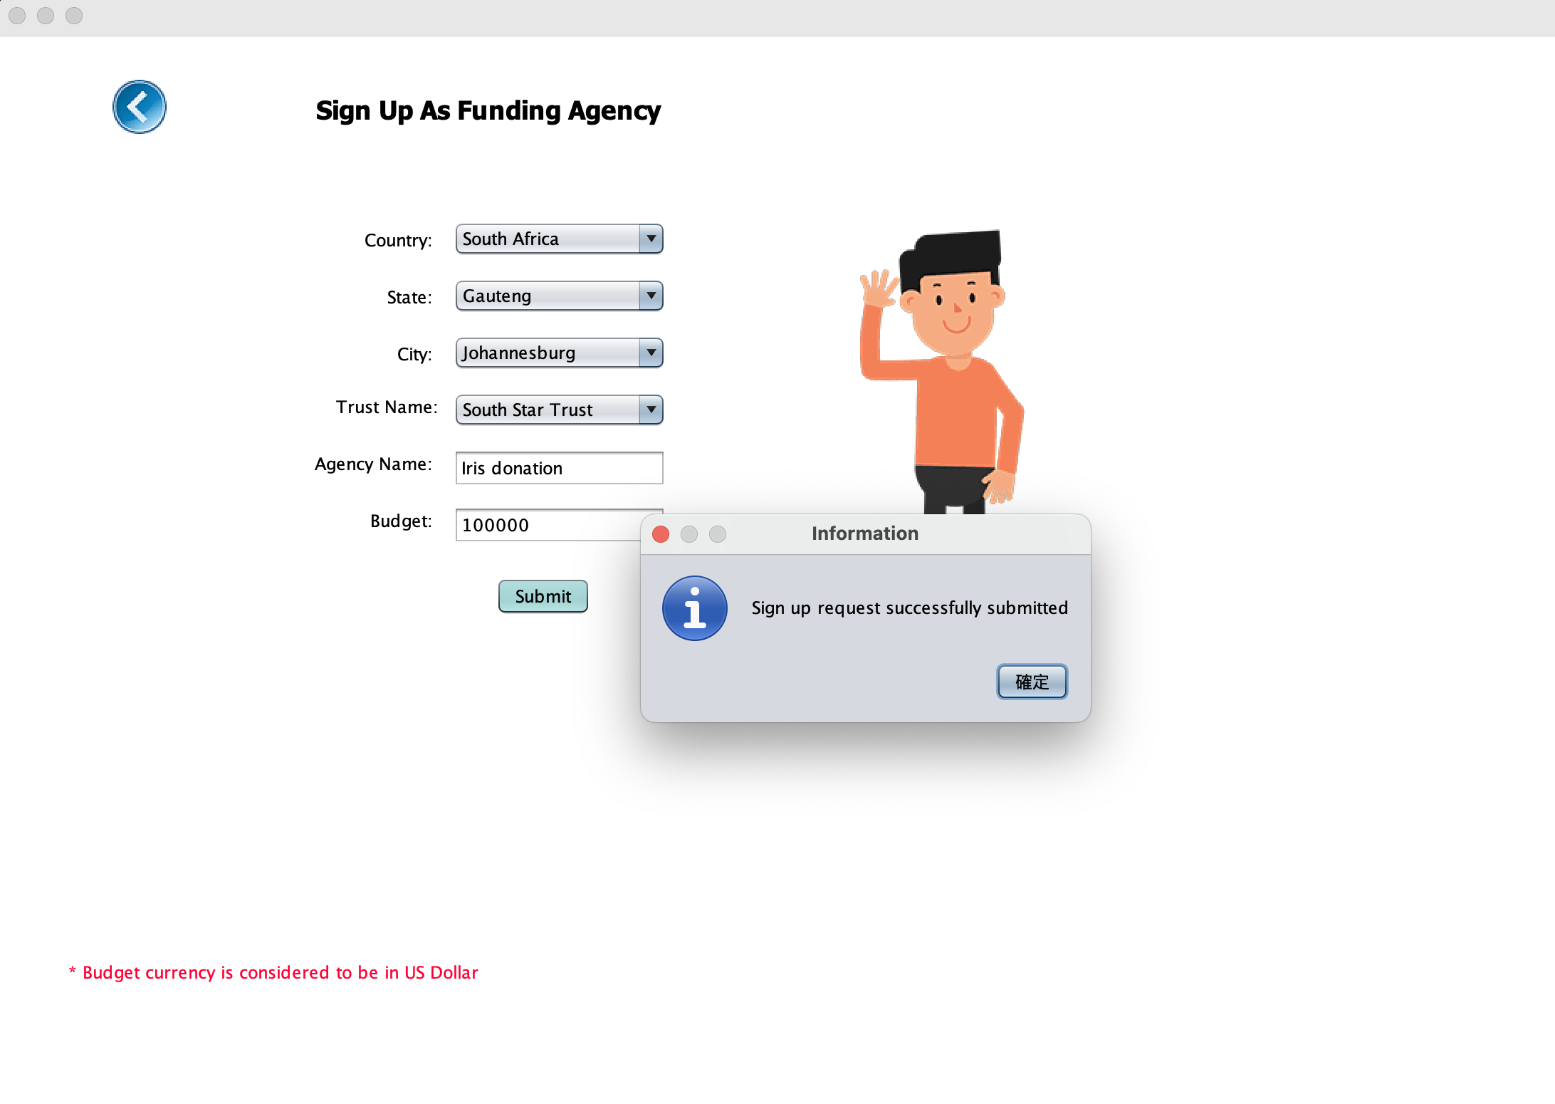
UI/UX – Sign Up (Funding page)
Intuitive user experience
(data validations, and messages) for new members’ registration

Slide 13
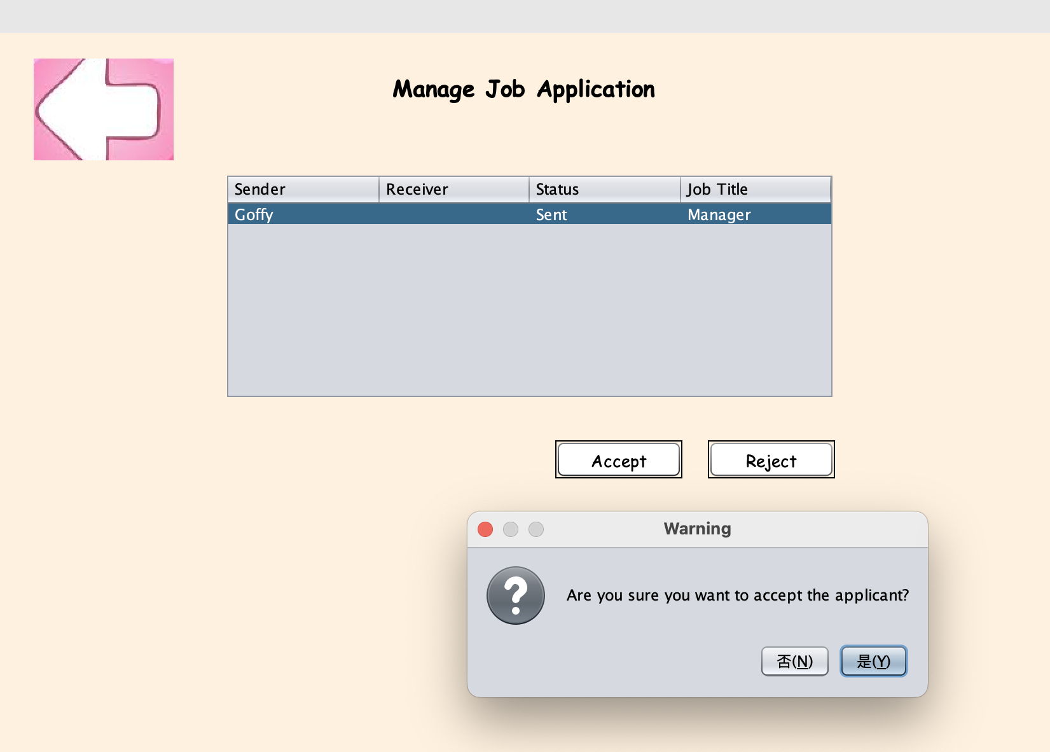
UI/UX – Job Application
Use messages to interact with applicants, throwing Java Swing Alert Dialog:
double confirmations at important steps

Slide 14
Demo

Slide 15
INTRODUCTION
Here you can give a brief description of the topic you want to talk about. For example, if you want to talk about Mercury, you can say that it’s the smallest planet in the entire Solar System

Slide 16
01.
OUR CENTER
You can enter a subtitle here if you need it

Slide 17
AWESOME WORDS

Slide 18

A PICTURE IS WORTH A THOUSAND WORDS

Slide 19
THIS IS A MAP
VENUS
Venus is the second planet from the Sun
MARS
Despite being red, Mars is actually a cold place
SUN
It’s the star at the center of the Solar System

Slide 20
OUR CENTER
Do you know what helps you make your point clear? Lists like this one:
They’re simple
You can organize your ideas clearly
You’ll never forget to buy milk!
And the most important thing: the audience won’t miss the point of your presentation

Slide 21
MISSION
VISION
Mercury is the smallest planet and the closest one to the Sun
Neptune is the farthest planet from the Sun. It's also the fourth-largest

Slide 22
MILESTONES REACHED
EARTH
VENUS
It’s the third planet from the Sun
Venus has a beautiful name
2003-2005
2005-2007
2007-2009
2009-2011
2011-2012
PLUTO
MERCURY
MARS
It’s now considered a dwarf planet
It’s the closest planet to the Sun
Mars is actually a cold place

Slide 23
KEY ACCOMPLISHMENTS
MERCURY
VENUS
MARS
Mercury is the closest planet to the Sun and the smallest one
Venus has a beautiful name and is the second planet from the Sun
Despite being red, Mars is actually a cold place. It's full of iron oxide dust

Slide 24
KEY NUMBERS
120,000
30,000
5,000
Pluto is now considered a dwarf planet
Mars is actually a cold place
Mercury is the smallest of them all

Slide 25
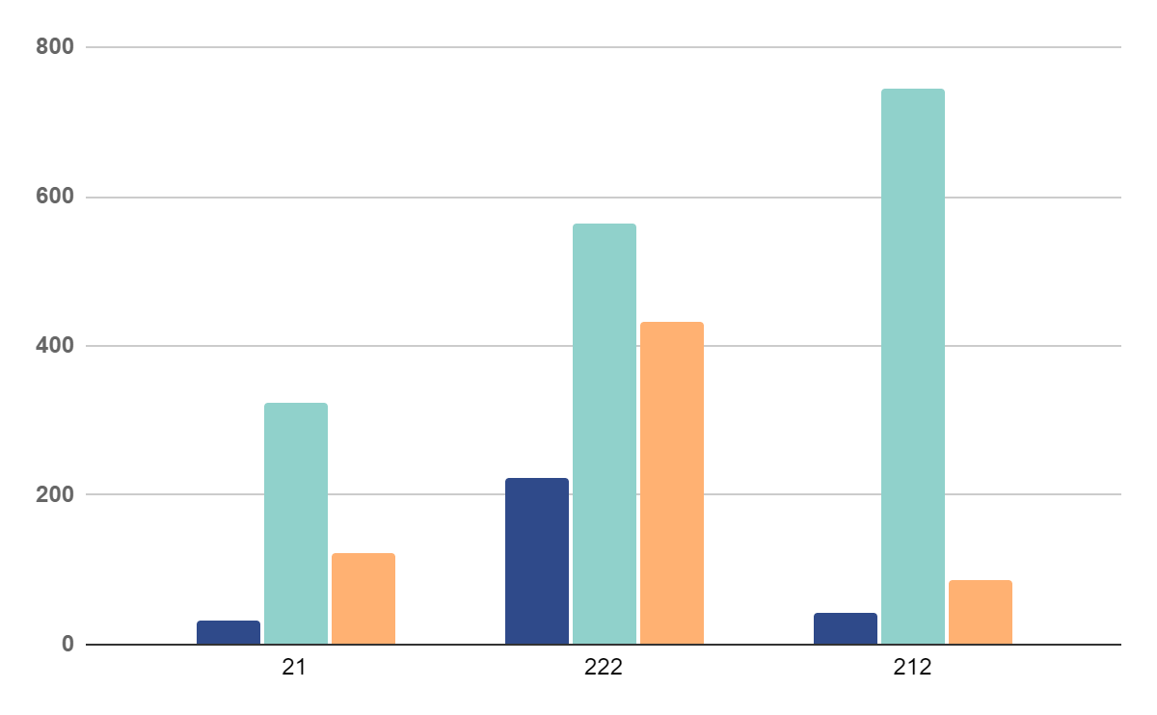
OUR GRAPHS
MERCURY
Mercury is the closest planet to the Sun and the smallest one
VENUS
Venus has a beautiful name and is the second planet
MARS
Despite being red, Mars is actually a cold place full of iron oxide
* To modify this graph, click on it, follow the link, change the data and paste the new graph here, replacing this one.
You can see how to modify the graph here

Slide 26
SERVICES
MERCURY
MARS
VENUS
NEPTUNE
Mercury is the closest planet to the Sun and the smallest one
Despite being red, Mars is actually a cold place. It's full of iron oxide dust
Venus has a beautiful name and is the second planet from the Sun
Neptune is the farthest planet from the Sun. It's also the fourth-largest

Slide 27
QUALITY IMPROVEMENT MEASURES
 | MERCURY | MARS
JUPITER | Mercury is the smallest planet of them all | Jupiter is made of gas and it’s the biggest planet of them all
SATURN | Venus is the second planet from the Sun | Saturn is a gas giant and has several rings
VENUS | Despite being red, Mars is actually a cold place | Neptune is the farthest planet from the Sun

Slide 28
OUR PROCESS
JUPITER
MERCURY
Jupiter is a gas giant and the biggest planet
Mercury is the closest planet to the Sun
NEPTUNE
PLUTO
Neptune is the farthest planet from the Sun
It’s now considered a dwarf planet

Slide 29
AWARDS
MERCURY
VENUS
MARS
Mercury is the closest planet to the Sun and the smallest one
Venus has a beautiful name and is the second planet
Despite being red, Mars is actually a cold place. It's full of iron oxide

Slide 30

PATIENT CARE
Neptune is the farthest planet from the Sun. It's also the fourth-largest object by diameter in the Solar System

Slide 31
20,000,000
Big numbers catch your audience’s attention

Slide 32
PATIENT SATISFACTION
JUPITER
20%
30%
MERCURY
50%
NEPTUNE
Jupiter is a gas giant and the biggest planet
Mercury is the closest planet to the Sun
Neptune is the farthest planet from the Sun

Slide 33
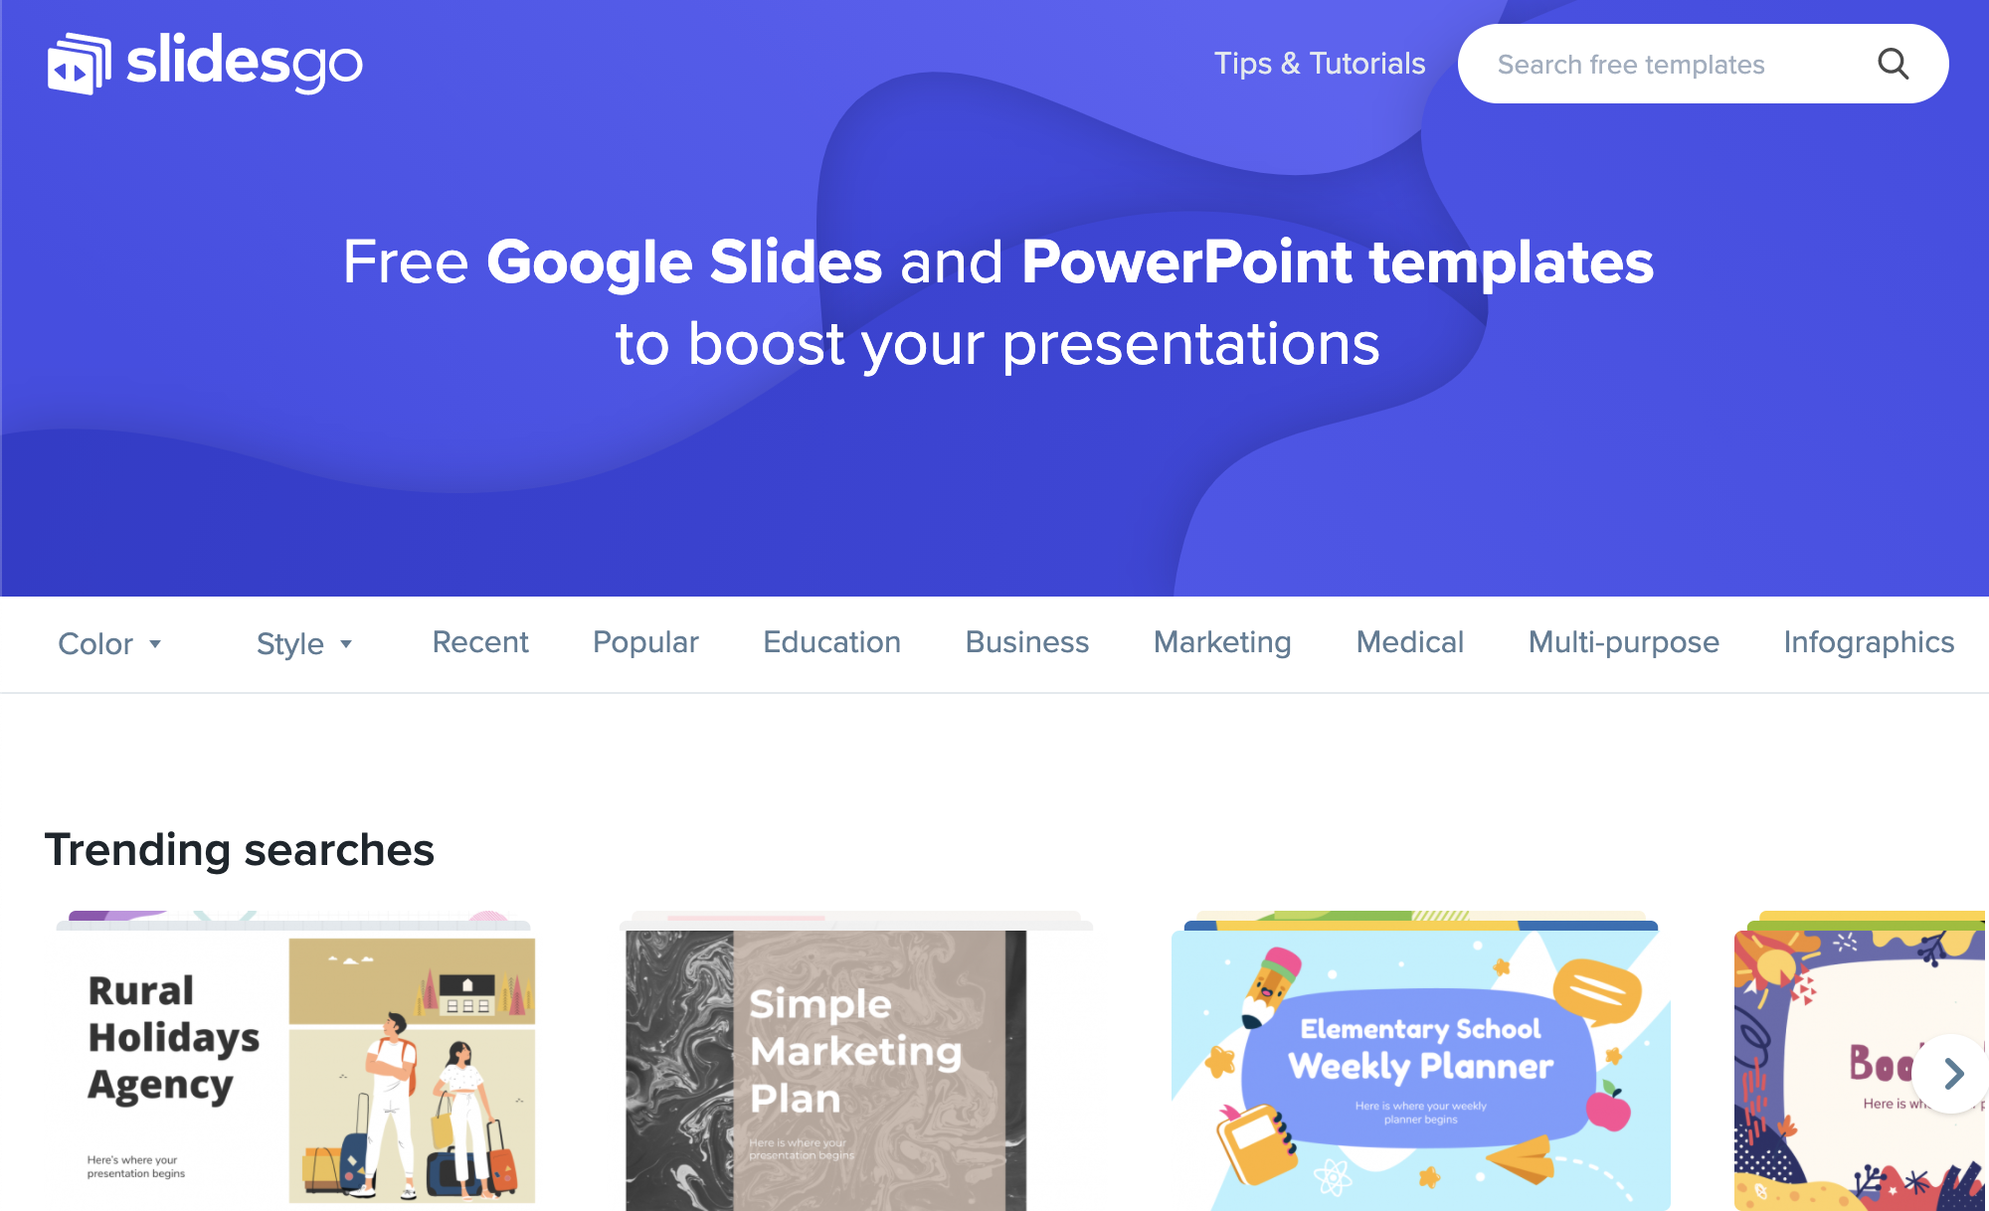
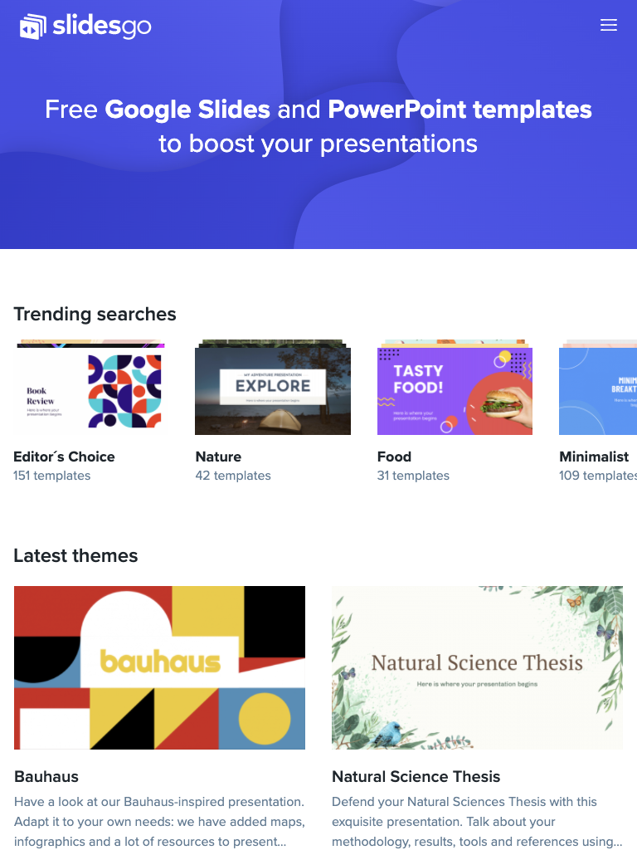
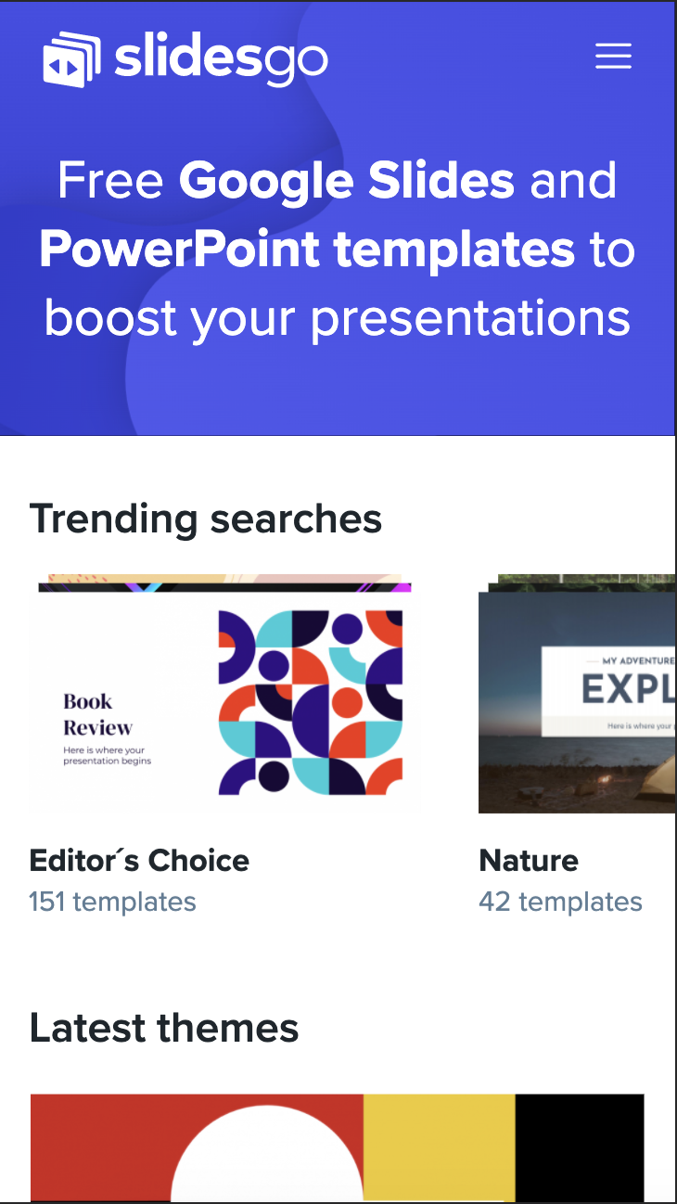
VISIT OUR WEBSITE!
You can replace the image on the screen with your own work. Just right-click on it and select “Replace image”

Slide 34
THANKS!
Do you have any questions?
youremail@freepik.com
+91 620 421 838
yourcompany.com
Please keep this slide for attribution

